Slide 1
Logistic Regression using Python
Notes:
Notes:
Do: <Explain what the facilitator needs to do.>.
Tell: <Summarize what the facilitator needs to say.>
Ask: <List the question/s the facilitator should ask the participants.>
Expected Responses: <List the responses facilitator might get from the participants on the asked question/s.>
Show: <List what the facilitator needs to show.>

Slide 2
CONTENTS
Over view to classification problems
Build models
Model measurements
Model Diagnostics

Slide 3
Classification problems
Classification problems an important category of problems in analytics in which the outcome variable takes discrete values.
Classification problems may have binary or multiple outcomes or class.
Binary outcome called binary classification and multiple outcomes are called multinomial classification
Several techniques to solve classification problems ; such as logistic regression, classification trees, discriminant analysis, neural networks and support vector machines
Primary objective of a classification model is to predict the probability of an observation belonging to a class ,known as class probability; Examples are
A bank would like to classify the customer as low risk & high risk customers
Predict whether a customer likely to churn or not
Health service: disease diagnostics of Patient based on positive or negative
HR : Applicant will accept the offer or not

Slide 4
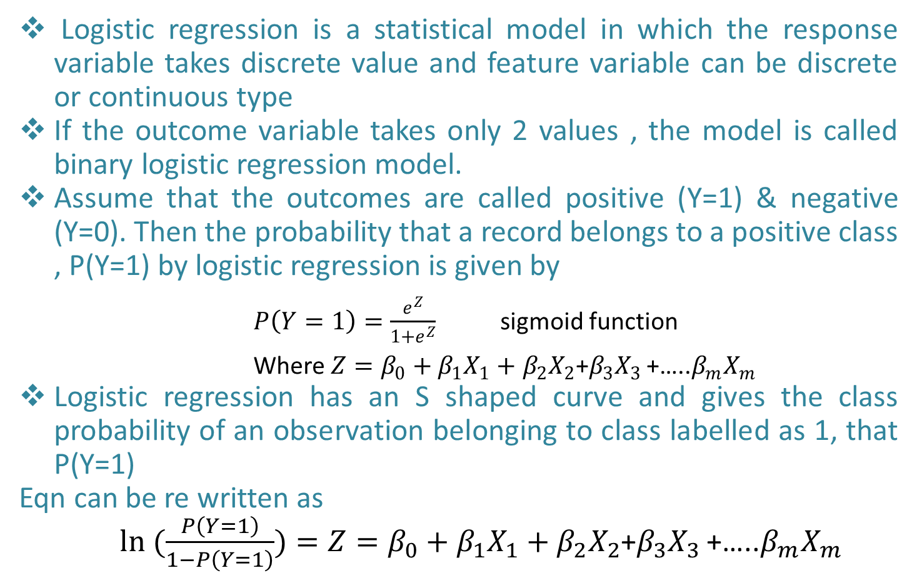
Binary Logistic Regression
Logistic regression is a statistical model in which the response variable takes discrete value and feature variable can be discrete or continuous type
If the outcome variable takes only 2 values , the model is called binary logistic regression model.
Assume that the outcomes are called positive (Y=1) & negative (Y=0). Then the probability that a record belongs to a positive class , P(Y=1) by logistic regression is given by
$P\left(Y=1\right)=\frac{e^{Z}}{1+e^{Z}}$ sigmoid function
Where $Z=β_{0}+β_{1}X_{1}+$ $β_{2}X_{2}$+$β_{3}X_{3 }$+…..$β_{m}X_{m}$
Logistic regression has an S shaped curve and gives the class probability of an observation belonging to class labelled as 1, that P(Y=1)
Eqn can be re written as
$ln (\frac{P\left(Y=1\right)}{1−P\left(Y=1\right)})=Z=β_{0}+β_{1}X_{1}+$ $β_{2}X_{2}$+$β_{3}X_{3 }$+…..$β_{m}X_{m}$

Slide 5
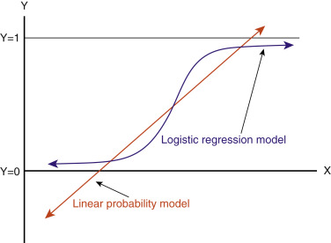
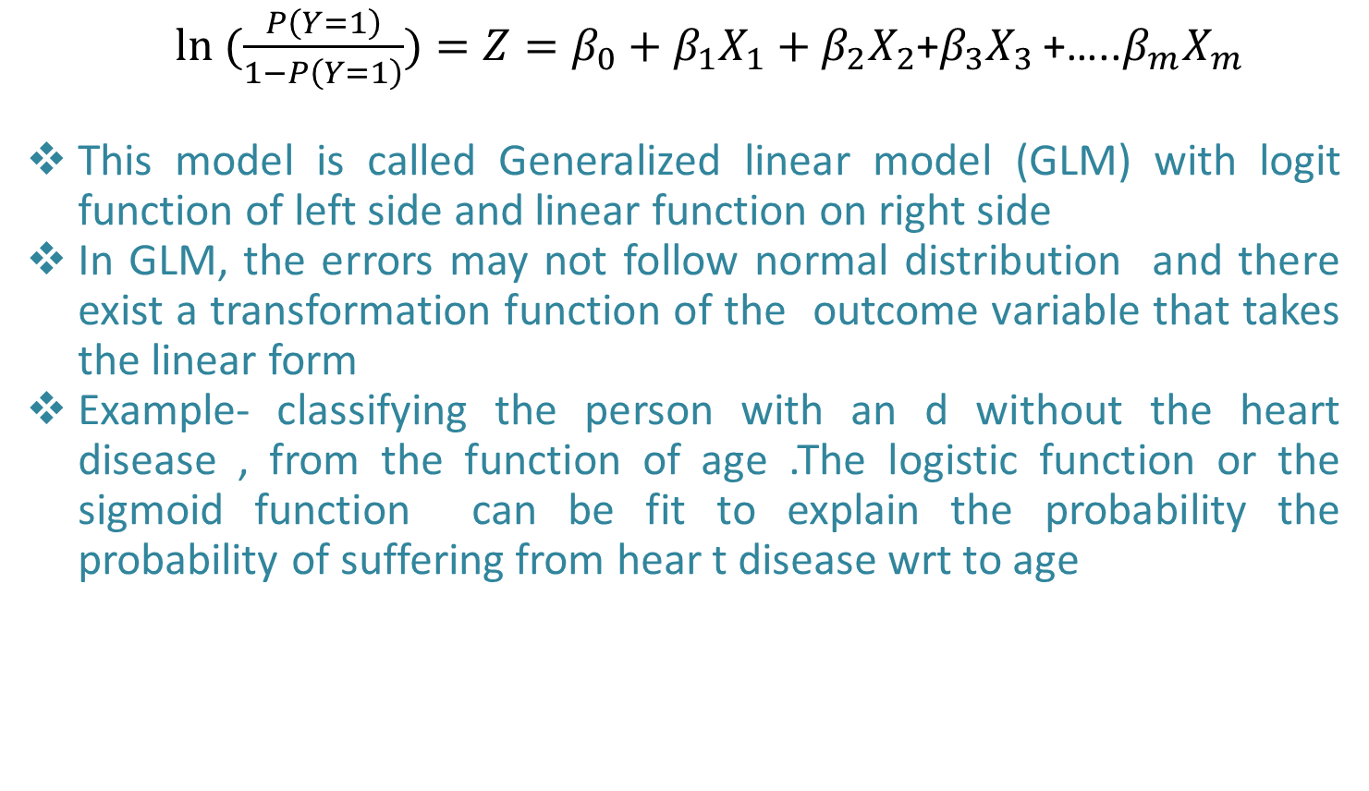

Binary Logistic Regression
$ln (\frac{P\left(Y=1\right)}{1−P\left(Y=1\right)})=Z=β_{0}+β_{1}X_{1}+$ $β_{2}X_{2}$+$β_{3}X_{3 }$+…..$β_{m}X_{m}$
This model is called Generalized linear model (GLM) with logit function of left side and linear function on right side
In GLM, the errors may not follow normal distribution and there exist a transformation function of the outcome variable that takes the linear form
Example- classifying the person with an d without the heart disease , from the function of age .The logistic function or the sigmoid function can be fit to explain the probability the probability of suffering from hear t disease wrt to age
$P\left(Heart Disease=1\right)=\frac{e^{β_{0}+β_{1}∗Age}}{1+e^{e^{β_{0}+β_{1}∗Age}}}$

Slide 6
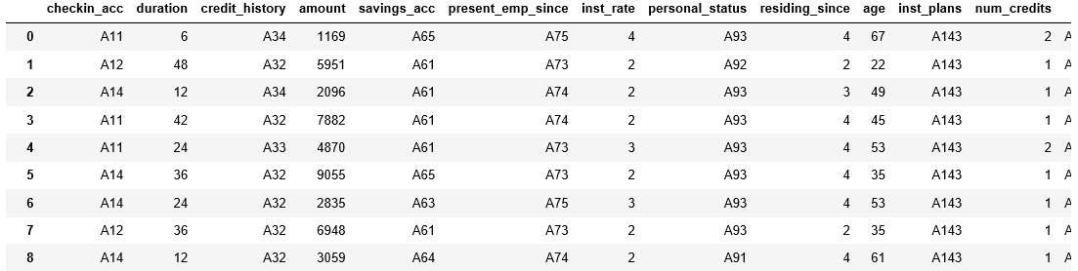
Logistic regression: Credit classification use case
Data set- German credit data.csv from UCL machine learning library
Data & Problem description:
To predict whether the credit is a good or bad credit
Credit classification is one of the popular classification problems encountered by financial institutions. For example, when a customer applies for a loan, bank would like to predict the probability of default.

Slide 7
Logistic regression: Model Diagnostics
Measures to validate logistic regression
Wald’s test (Chi square test) for checking the statistical significance of individual predictor (feature variables). This is equivalent to t-test in MLR
Likelihood ratio test for checking the statistical significance of the overall model (LLR p value). This test also used for feature selection
Pseudo R2: Measurement of goodness of fit of the model , it doesn’t have the same interpretation of R2 in SLR model

Slide 8
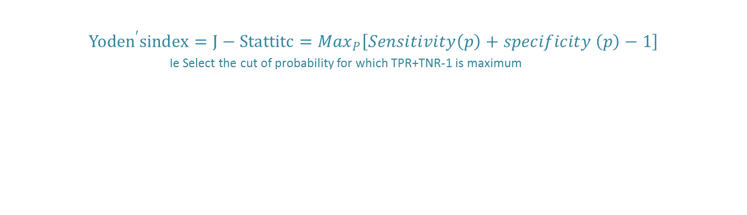
Optimal Classification cut -off
To understand how many observations predicted correctly and not, generally assumed a cut off probability . If it is 0.5 , above 0.5 will be 1 (bad credit) and below 0.5 will be considered as zero (good credit)
The overall accuracy, sensitivity and specificity will depend on the chosen cut off probability
Two methods to calculate cut off probability
Youden’s index
Cost based approach
Youden’s Approach
$${Yoden}^{′}sindex=J−Stattitc={Max}_{P}\left[Sensitivity\left(p\right)+specificity \left(p\right)−1\right]$$
Ie Select the cut of probability for which TPR+TNR-1 is maximum
Cost based approach
…………….

Slide 9
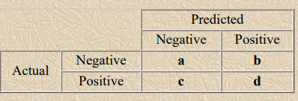
Confusion matrix
Known as error matrix sometimes or classification table, formed by checking the actual & predicted values of observation in the data set
The following table shows the confusion matrix for a two class classifier.
a is the number of correct predictions that an instance is negative
b is the number of incorrect predictions that an instance is positive, c is the number of incorrect of predictions that an instance negative,
D is the number of correct predictions that an instance is positive.

Slide 10
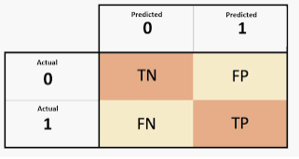
Measuring Accuracies
Sensitivity or Recall or TP rate: the proportion of positive cases that were correctly identified, as calculated using the equation
Sensitivity= TP/(TP+FN)
Specificity or TN rate: the proportion of negatives cases that were classified correctly,
Specificity= TP/(TP+FN)
Precision: proportion of the predicted positive cases that were correct
Specificity= TP/(TP+FP)
F-Score : combines the precision and recall (HM b/w two)
F-score= (2*recall*precision)/(recall+ precision)

Slide 11
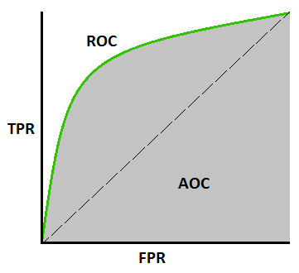
ROC & AUC
Understand the overall performance of logistic regression model
A receiver operating characteristic curve, or ROC curve, is a graphical plot that illustrates the diagnostic ability of a binary classifier system as its discrimination threshold is varied.
ROC: Sensitivity (TP Rate) Y Axis & specificity X axis
ROC with length a and breadth b; the diagonal line makes the area to 2 right angled triangle of 0.5 ab each area.
AUC is the area consider above diagonal line
Area>0.7 makes model practically good,
Note: Incase of imbalanced (may be less% +ve or –ve) data set, the AUC may be 0.9 but of either sensitivity or specificity values will be poor.

Slide 12
Gain & Lift chart
Understand the overall performance of logistic regression model
A receiver operating characteristic curve, or ROC curve, is a graphical plot that illustrates the diagnostic ability of a binary classifier system as its discrimination threshold is varied.
ROC: Sensitivity (TP Rate) Y Axis & specificity X axis
ROC with length a and breadth b; the diagonal line makes the area to 2 right angled triangle of 0.5 ab each area.
AUC is the area consider above diagonal line
Area>0.7 makes model practically good,
Note: Incase of imbalanced (may be less% +ve or –ve) data set, the AUC may be 0.9 but of either sensitivity or specificity values will be poor.

